Slide 1
Neural Style Transfer using PyTorch

Slide 2
Introduction
This project demonstrates Neural Style Transfer (NST), which merges the content of one image with the style of another using a pre-trained VGG19 model in PyTorch.
• Framework: PyTorch
• Model: VGG19
• Optimization: Adam
• Device: GPU/CPU compatible

Slide 3
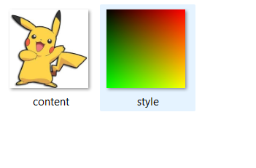
Input and Output Images

Slide 4
Code Overview
1. Load and preprocess content and style images.
2. Extract features using selected layers from VGG19.
3. Compute Gram matrices for style representation.
4. Optimize a target image to minimize content and style losses.
5. Save intermediate and final stylized outputs.

Slide 5

GPU vs CPU test
import torch, time
device = torch.device('cuda' if torch.cuda.is_available() else 'cpu')
print("Running on:", device)
# Matrix multiplication timing test
size = 4096
x = torch.randn(size, size, device=device)
y = torch.randn(size, size, device=device)
start = time.time()
z = torch.matmul(x, y)
torch.cuda.synchronize()
print("Time:", time.time() - start, "seconds")

Slide 6
Style_transfer.py
import torch
import torch.nn as nn
import torch.optim as optim
from torchvision import models, transforms, utils
from PIL import Image
import os
# ✅ Device setup
device = torch.device("cuda" if torch.cuda.is_available() else "cpu")
print("Running on:", device)
# ✅ Ensure output folder exists
os.makedirs("output", exist_ok=True)
# ✅ Image loader
def load_image(path, max_size=512):
image = Image.open(path).convert("RGB")
size = min(max(image.size), max_size)
transform = transforms.Compose([
transforms.Resize(size),
transforms.CenterCrop(size),
transforms.ToTensor(),
])
image = transform(image).unsqueeze(0)
return image.to(device)
content = load_image("input/content.jpg")
style = load_image("input/style.jpg")
# ✅ Normalize for VGG
normalization_mean = torch.tensor([0.485, 0.456, 0.406]).to(device)
normalization_std = torch.tensor([0.229, 0.224, 0.225]).to(device)
normalization = transforms.Normalize(mean=normalization_mean, std=normalization_std)

Slide 7
def normalize_batch(batch):
return normalization(batch.squeeze(0)).unsqueeze(0)
# ✅ Model and layers
vgg = models.vgg19(weights=models.VGG19_Weights.DEFAULT).features.to(device).eval()
for param in vgg.parameters():
param.requires_grad_(False)
layers = {
'0': 'conv1_1',
'5': 'conv2_1',
'10': 'conv3_1',
'19': 'conv4_1',
'28': 'conv5_1'
}
def get_features(image, model):
features = {}
x = image
for name, layer in model._modules.items():
x = layer(x)
if name in layers:
features[layers[name]] = x
return features
def gram_matrix(tensor):
b, c, h, w = tensor.size()
tensor = tensor.view(c, h * w)
return torch.mm(tensor, tensor.t())
content_features = get_features(normalize_batch(content), vgg)
style_features = get_features(normalize_batch(style), vgg)
style_grams = {layer: gram_matrix(style_features[layer]) for layer in style_features}
content_weight = 1e0
style_weight = 1e6
num_steps = 400
target = content.clone().requires_grad_(True)
optimizer = optim.Adam([target], lr=0.01)
print("Training started...")

Slide 8
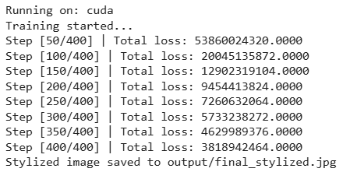
for step in range(1, num_steps + 1): target_features = get_features(normalize_batch(target), vgg)
# Content loss content_loss = torch.mean((target_features['conv4_1'] - content_features['conv4_1'])**2)
# Style loss style_loss = 0 for layer in style_grams: target_gram = gram_matrix(target_features[layer]) style_gram = style_grams[layer] layer_loss = torch.mean((target_gram - style_gram)**2) style_loss += layer_loss / (style_gram.numel()) total_loss = content_weight * content_loss + style_weight * style_loss optimizer.zero_grad() total_loss.backward() optimizer.step() if step % 50 == 0: print(f"Step [{step}/{num_steps}] | Total loss: {total_loss.item():.4f}") utils.save_image(target, f"output/step_{step}.jpg")
# ✅ Final save utils.save_image(target, "output/final_stylized.jpg") print("Stylized image saved to output/final_stylized.jpg")

Slide 9
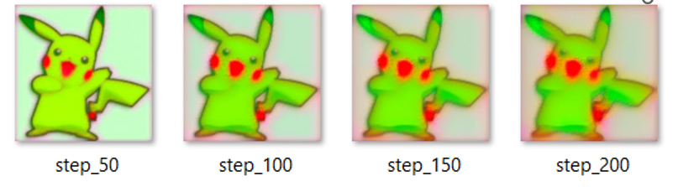
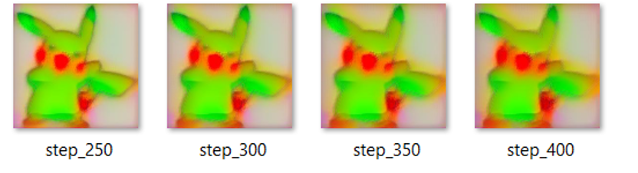
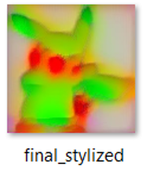
Stylization Process (Step Progression)

Slide 10
Observations
• The structural details of Pikachu are retained while color patterns from the style image are applied.
• Higher style weight increases artistic blending but can reduce clarity.
• GPU acceleration significantly speeds up optimization compared to CPU.

Slide 11
Conclusion
Neural Style Transfer effectively combines the visual essence of two images. This experiment showcases the creative potential of deep learning models like VGG19 in generating artistic image transformations.

